Slide 1
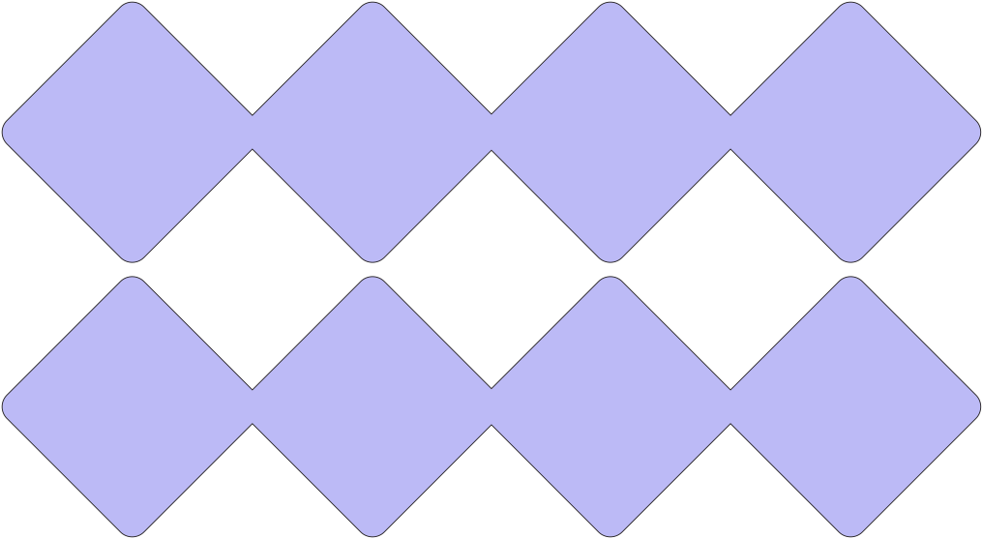



TEAM RPG DEV:
WIREFRAME AND INFORMATION ARCHITECTURE

Slide 2






INTRODUCTION
For Milestone 4, our task was to create the visual for our application based on our Market Research from Milestone 2. However, since we pivoted our original plan, majority of our implementation will be taken from informal interviews, online reviews, and research from other similar applications.
What we hope to achieve from milestone is to create an intuitive and visually appealing wireframe that covers the basis of user requirements.

Slide 3


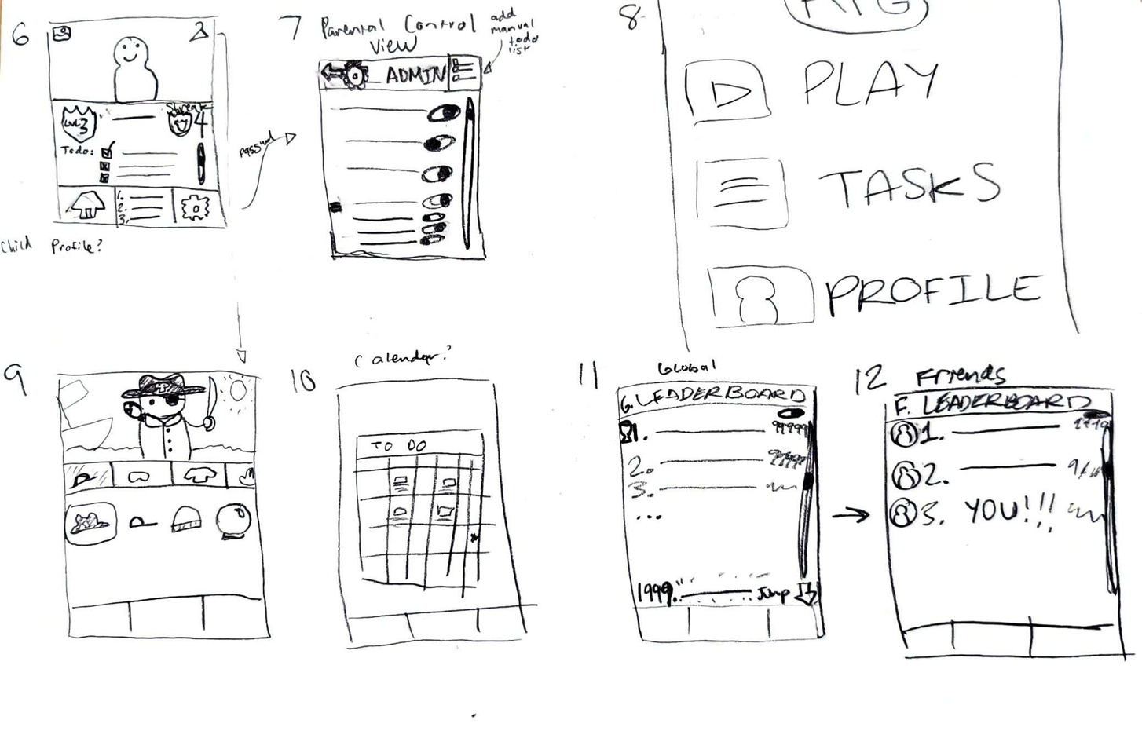
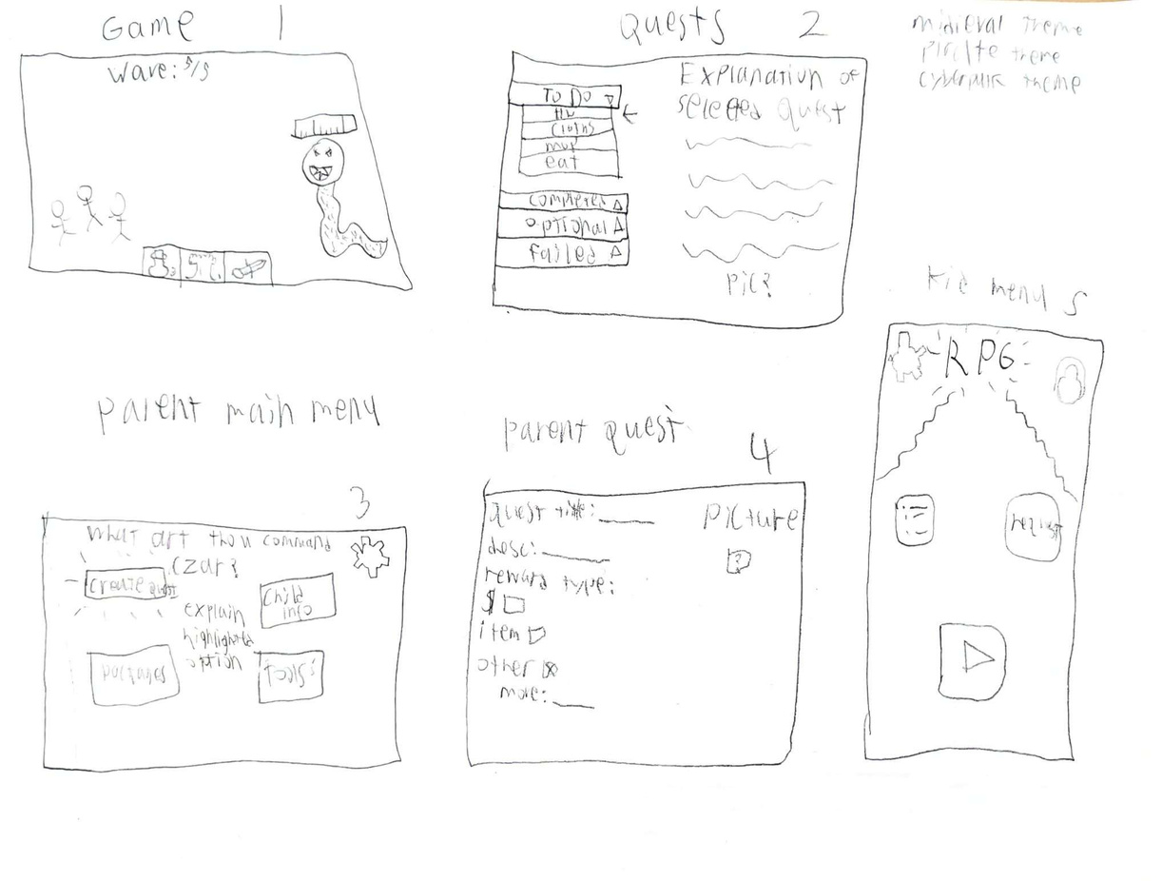
PAPER-BASED WIREFRAME VARIATIONS

Slide 4
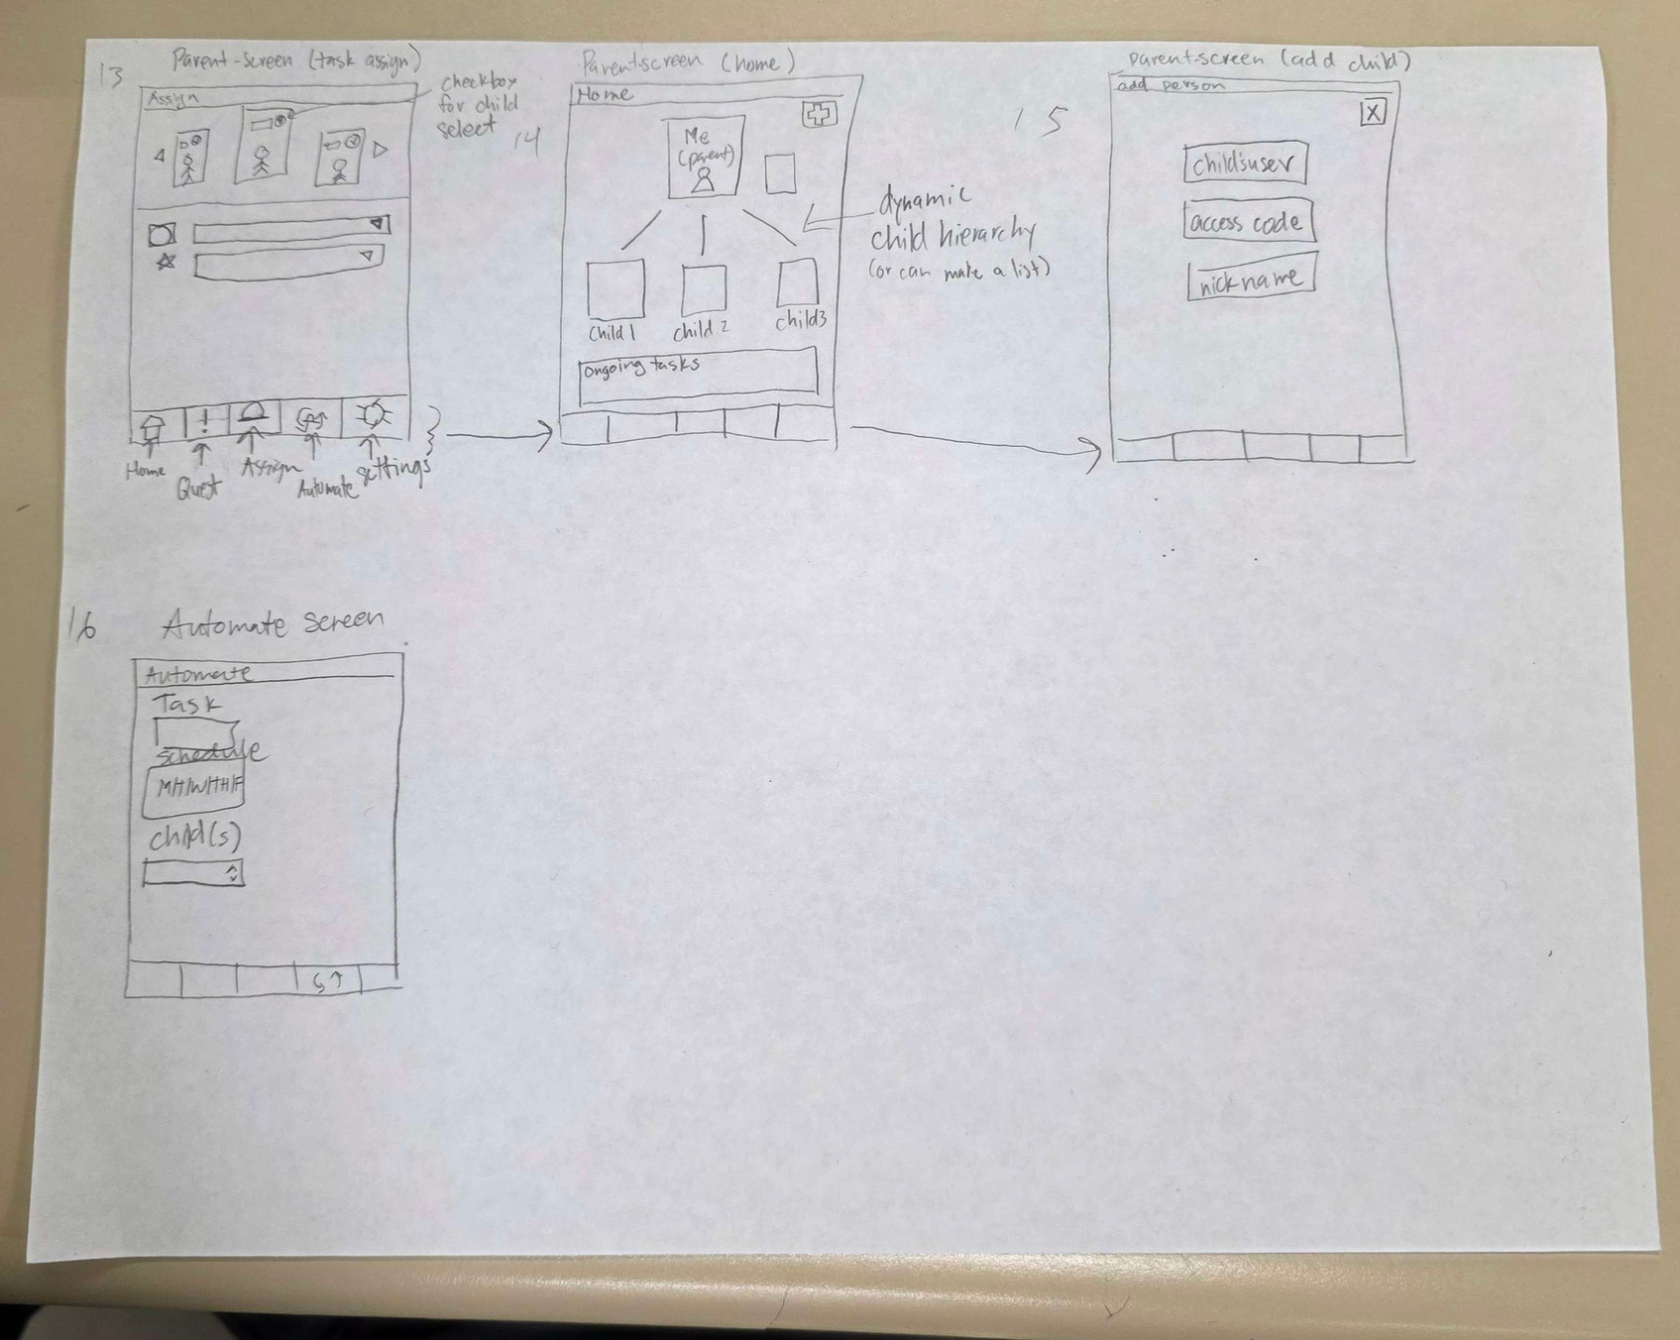
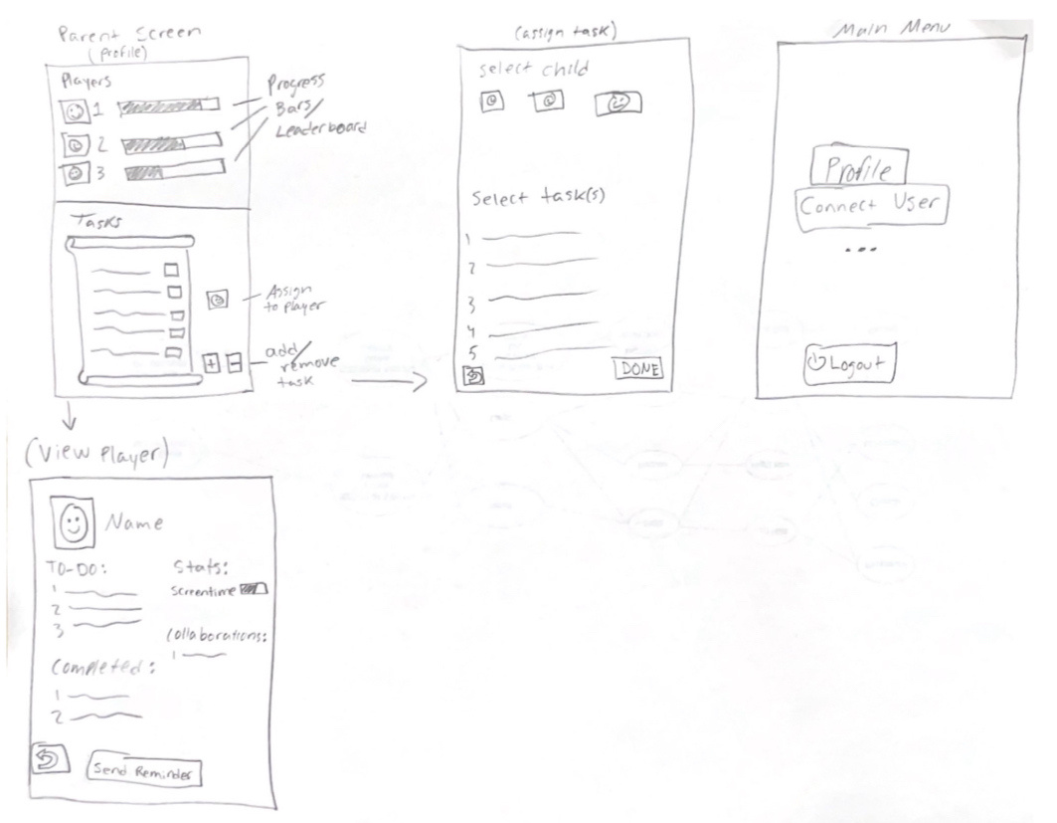
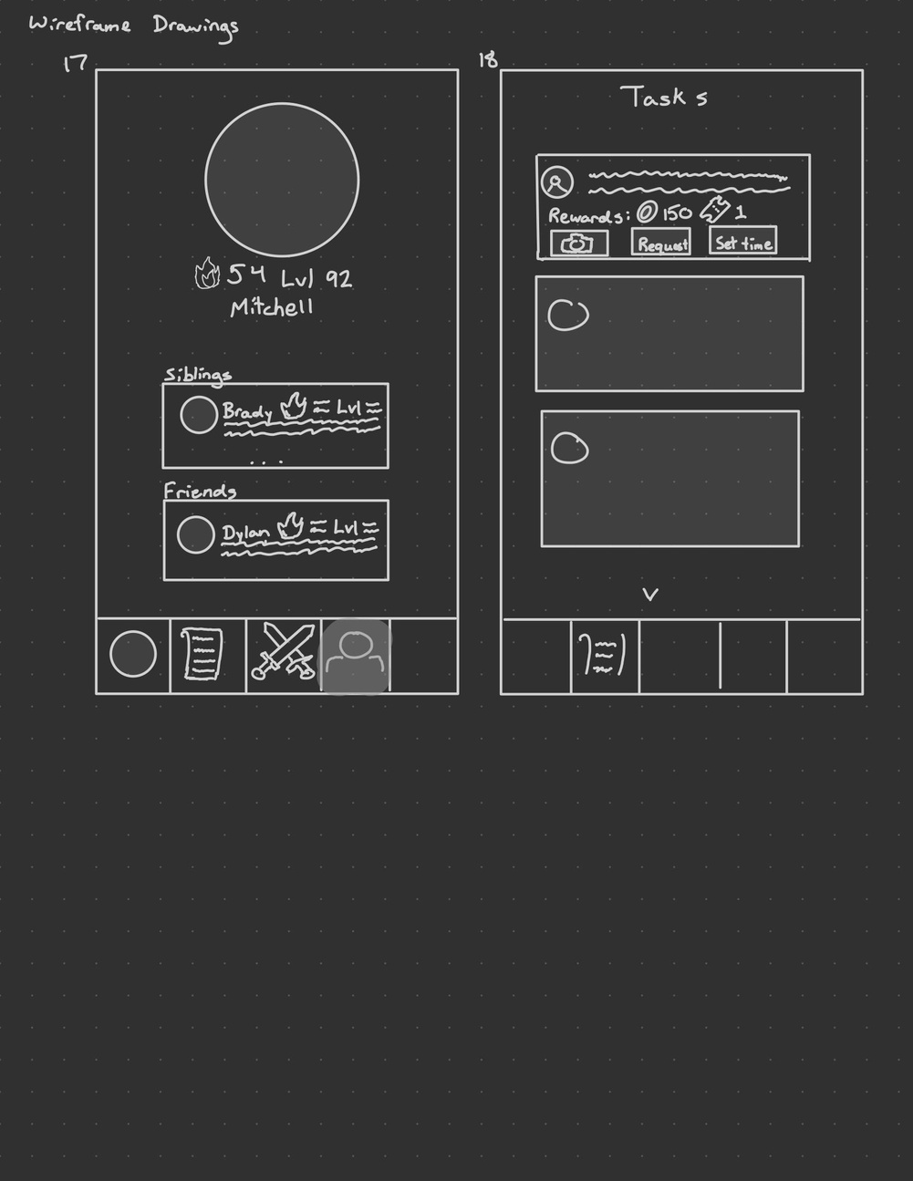
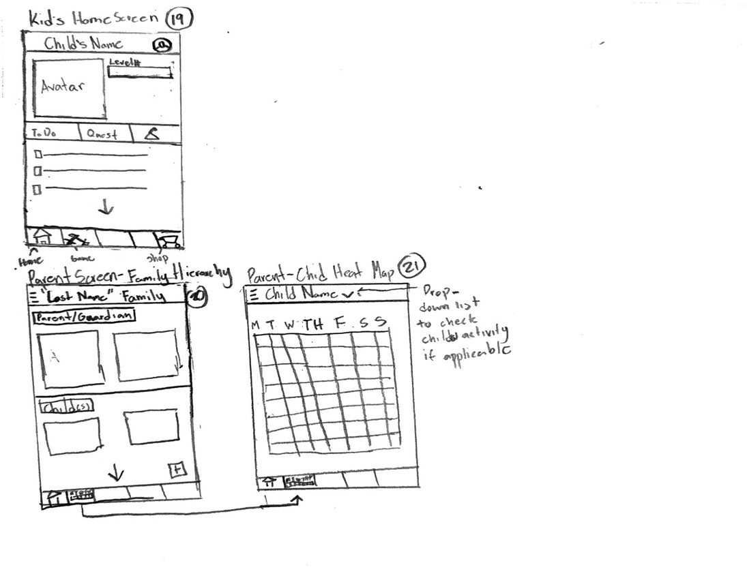

Slide 5
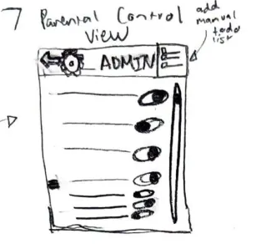
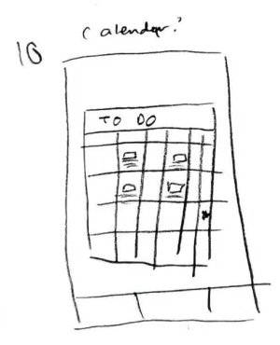
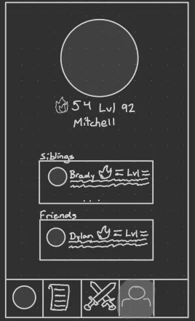
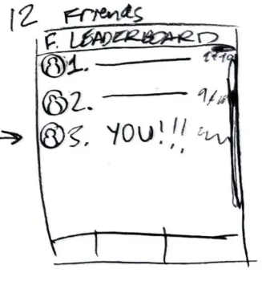
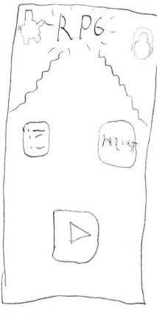
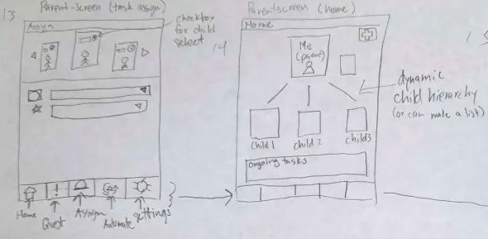
PAPER BASED WIREFRAMES
We created 25 different iterations of these paper based wireframes before we landed on our finalized version of the figma prototype.
We chose key features from multiple wireframes to incorporate into a final product that reflected chosen core features.

Slide 6
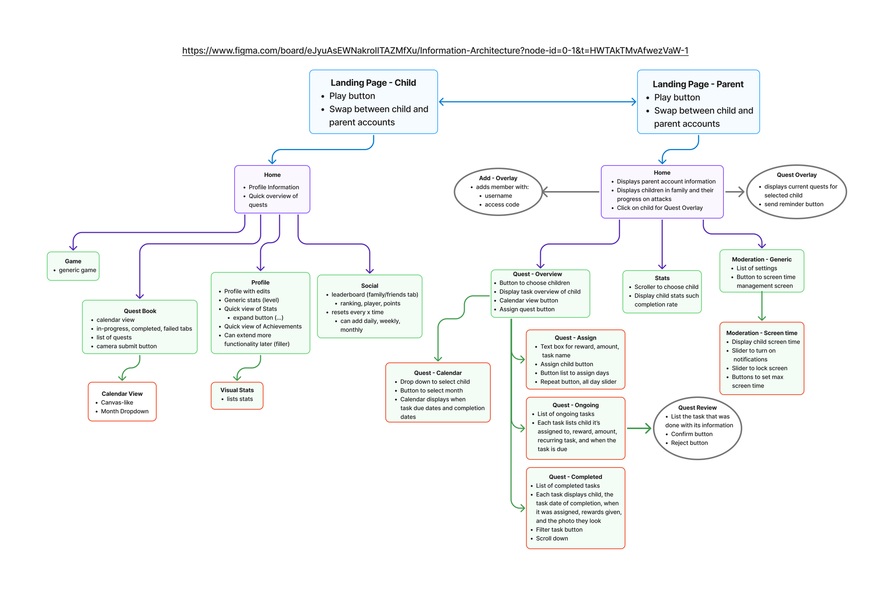



ARCHITECTURE OVERVIEW

Slide 7
PROTOTYPE DEMO
https://www.figma.com/proto/8tXyrViRvFoTmwiFB61lJl/Milestone-4--Low-Fidelity?node-id=0-1&t=WByoCh2mhNC2xSbH-1
Link:

Slide 8
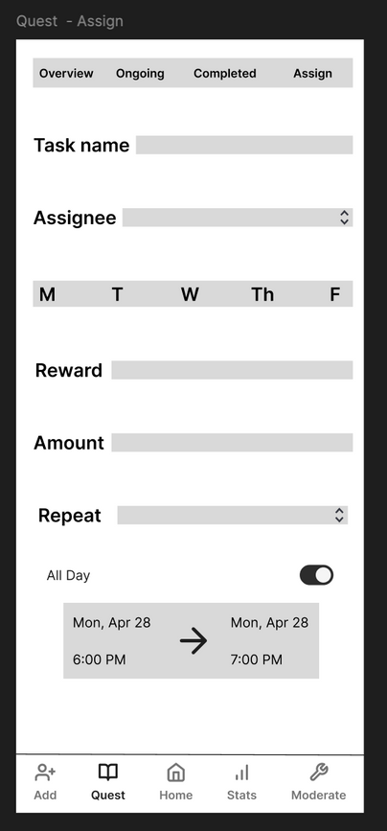
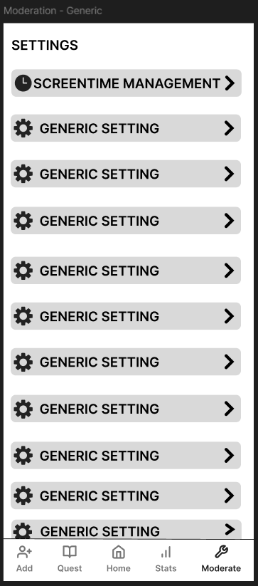
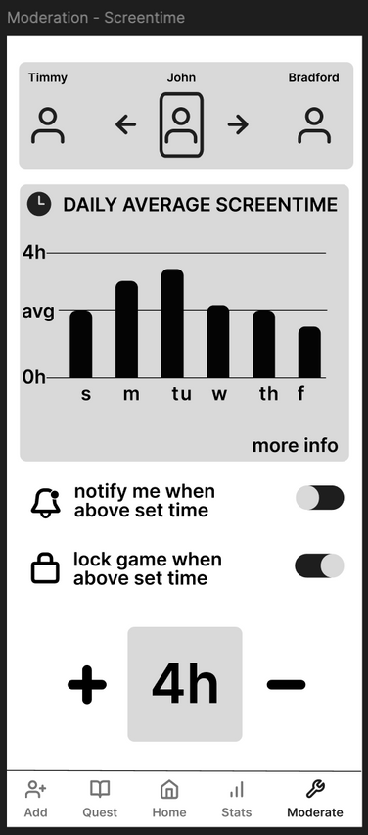
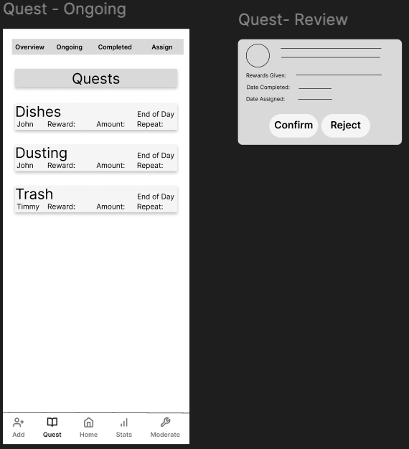
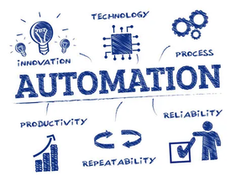
CORE FEATURES - PARENT
QUEST - ASSIGN
MODERATION
QUEST - REVIEW

Slide 9
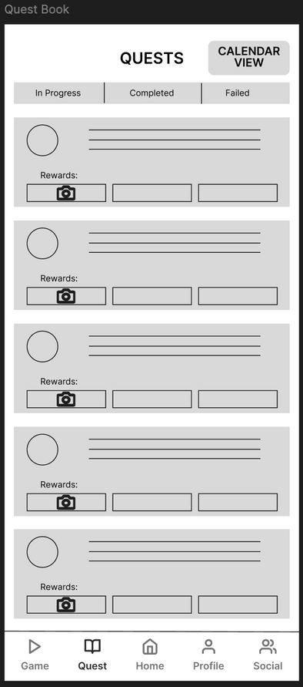
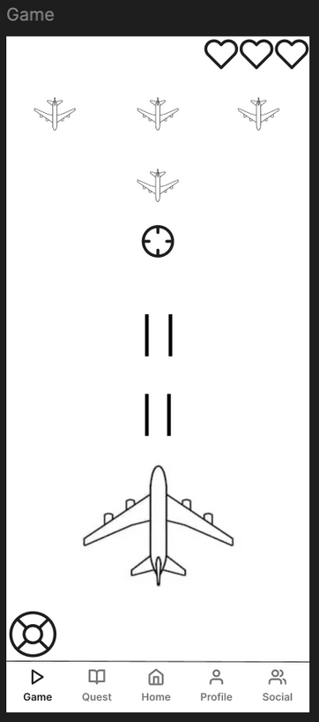
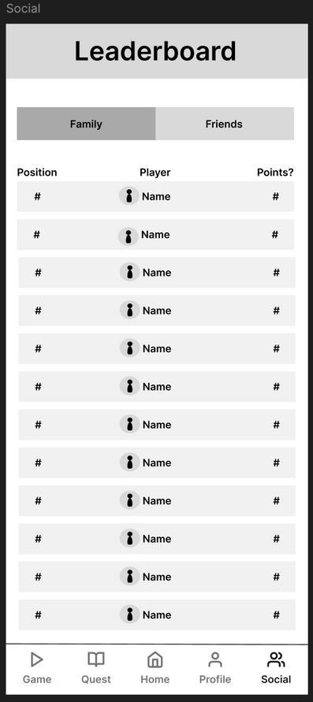
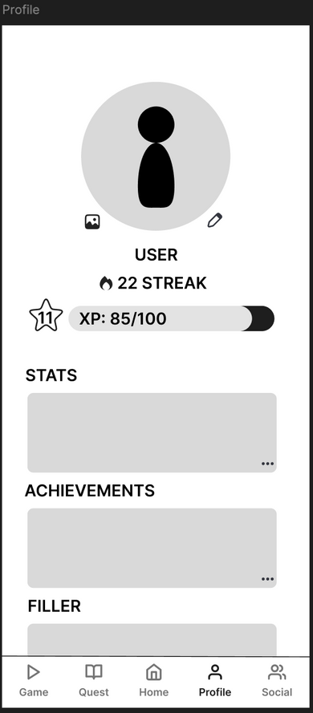
CORE FEATURES - CHILD
QUEST
GAME
SOCIAL
PROFILE

Slide 10


Our design choices were centered around making the app as simple and intuitive as possible
Our parent screens put an emphasis on giving control in various aspects
For child screen, we wanted the design to feel engaging on how tasks and gamification are presented
Future Work: Define the game we are making, establish the relationship between the game and tasks rewards
Perform more informal interviews focused our new child/parent personas
CONCLUSION
AND
FUTURE WORK

